Slide 1
Software Prototyping

Slide 2
Software Prototype
A prototype is an initial version of a system used to demonstrate concepts and try out design options.
A prototype can be used in:
The requirements engineering process to help with requirements elicitation and validation;
In design processes to explore options and develop a UI design;
In the testing process to validate requirement.

Slide 3
System prototyping
Prototyping is the rapid development of a system
The principal use is to help customers and
developers understand the requirements for the
system
Requirements elicitation – Users can experiment with a
prototype to see how the system supports their work
• Requirements validation – The prototype can reveal
errors and omissions in the requirements
Prototyping can be considered as a risk reduction
activity

Slide 4
Prototyping benefits
Misunderstandings between software users and
developers are exposed
Missing services may be detected and confusing
services may be identified
A working system is available early in the process
The prototype may serve as a basis for deriving a
system specification
The system can support user training and system
testing

Slide 5
Prototyping in the software process
Evolutionary prototyping: An initial prototype is produced and refined through a number of stages to the final system
Throw-away prototyping: A prototype is produced to help discover requirements problems and then discarded. The system is then developed using some other development process.
It may be impossible to tune the system to meet non-functional requirements;
Prototypes are normally undocumented;
The prototype probably will not meet normal organisational quality standards.

Slide 6
Evolutionary prototyping
The idea behind Evolutionary prototyping is that an initial prototype is presented to the user. They provide feedback and suggestions for improvements.
These are actioned by the developer who then presents a more refined prototype. The user once more provides feedback. The process is repeated.
So at each stage the prototype 'evolves' towards the final system.
Hence the term 'evolutionary prototyping'.

Slide 7
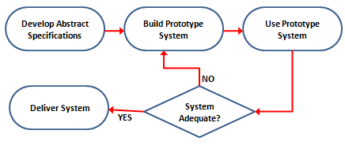
Evolutionary prototyping

Slide 8
An example:
Developing the user input screen in a new customer records system.
1. Working with the analyst, the developer quickly puts together an initial prototype . This prototype is then tried out by users who provide immediate feedback.
The initial prototype may not even look like the final system - it may be just trying out user interactions with no interest in how it looks at this stage. The developer will lay out the appropriate raw input boxes and navigation buttons but without any graphic or colour work.
2. Users try out the prototype and inform the analyst of any changes needed to the interactions (not commenting on graphics or how it looks).
3. The requirement specification is updated by the analyst and the developer adjusts the interactions as needed.
4. The user tries out the adjusted prototype. They can either accept how it is now working or they once again inform the analyst of any changes that should be made. The process repeats.
5. The interaction aspect of the interface is eventually accepted and signed off.
6. Now perhaps the developers begin work on the graphics and the way the input screen actually looks.
7. A new prototype is released, now with all the graphics set up properly. The user tries out the prototype and comments on the design. Any changes needed are added to the requirements specification and the developer carries out the changes.
8. The prototype evolves towards the finished system.

Slide 9
Evolutionary prototyping advantages
Accelerated delivery of the system
User engagement with the system

Slide 10
Contd…
Specification, design and implementation are
inter-twined
The system is developed as a series of increments
that are delivered to the customer
Techniques for rapid system development are
used such as CASE tools
User interfaces are usually developed using a GUI
development toolkit

Slide 11
Evolutionary prototyping problems
Management problems
Specialist skills are required which may not be
available in all development teams
Maintenance problems
Continual change tends to corrupt system structure so long-term maintenance is expensive

Slide 12
Contd..,
Some parts of the requirements may be
impossible to prototype
E.g., safety-critical functions
An implementation has no legal standing as a
contract
Non-functional requirements cannot be
adequately tested in a system prototype

Slide 13
Throw-away prototyping
With 'throw-away' prototyping a small part of the system is developed and then given to the end user to try out and evaluate. The user provides feedback which can quickly be incorporated into the development of the main system.
The prototype is then discarded or thrown away. This is very different to the evolutionary approach.

Slide 14
Contd…
The objective of throw-away prototyping is to ensure that the system requirements are validated and that they are clearly understood.
The throw-away prototype is NOT considered part of the final system. It is simply there to aid understanding and reduce the risk of poorly defined requirements. The full system is being developed alongside the prototypes and incorporates the changes needed.

Slide 15
Contd…
The advantage of this approach is the speed with which the prototype is put together. It also focuses the user on only one aspect of the system so keeping their feedback precise

Slide 16
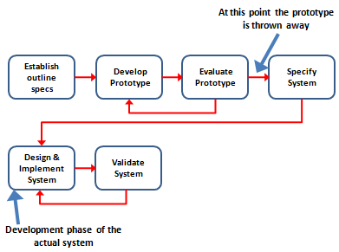
Contd..

Slide 17
Throw-Away Prototype Problems
Sometimes the cost of prototype development represents an unacceptably large fraction of the total cost
Customers are likely to force the developer to convert the prototype to the working system using a few fixes
The developer may become familiar with the prototype and reluctant to discard it

Slide 18
Rapid prototyping techniques
Various techniques may be used for rapid
development
Dynamic high-level language development
Database programming
Component and application assembly
These techniques are often used together
Visual programming is an inherent part of most
prototype development systems

